Slide 1

Measuring AI Accuracy
Precision, Recall, F-score, and Beyond
© 2020 The Atticus Project

Slide 2
How do we measure a model's accuracy?
Short answer: by checking against human-labeled contracts.
Example:
Model takes 3 human-labeled contracts.
compute
Contract 1
Contract 2
training
Model
testing
Contract 3
recall, precision,
f-score
The AI tool compares the labels predicted by the model vs. the labels done by humans, and computes recall, precision, and f-score
The AI tool removes the labels in Contract 3, and asks the model to predict labels on its own
Model uses Contracts 1 and 2 to train

Slide 3
Metrics of Accuracy
Precision
Recall
F-score
There are two main metrics of accuracy: precision and recall, which together form a third metric known as F-score.
All three metrics lie on a scale from 0 to 1, and are calculated based on what the model gets right vs wrong.

Slide 4
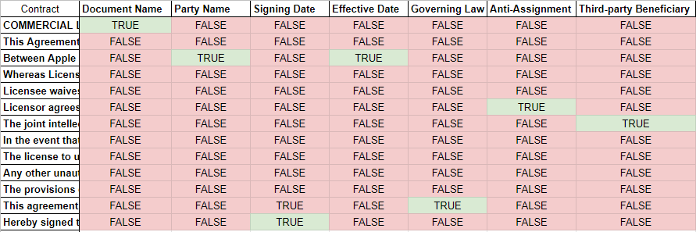
Binary Classification (True/False)
For each clause, the model is expected to give a true/false prediction, for each label.

Slide 5
Human Label
 | True | False
True | True Positive
False
Model Prediction
True Positive: a clause that a human marks as true and the model also marks as true.

Slide 6
Human Label
 | True | False
True | True Positive | False Positive
False
Model Prediction
False Positive: a clause that a human marks as false and the model incorrectly marks as true.

Slide 7
Human Label
 | True | False
True | True Positive | False Positive
False | False Negative
Model Prediction
False Negative: a clause that a human marks as true and the model incorrectly marks as false.

Slide 8
Human Label
 | True | False
True | True Positive | False Positive
False | False Negative | True Negative
Model Prediction
True Negative: a clause that a human marks as false and the model also marks as false.

Slide 9
Human Label
 | True | False
True | True Positive | False Positive
False | False Negative | True Negative
Model Prediction

Slide 10
Human Label
 | True | False
True | True Positive | False Positive
False | False Negative | True Negative
Model Prediction
Recall is the percentage of clauses labelled “true” by a human, that were also labelled “true” by the model. Intuitively, it measures how well the model was able to “recall” the clauses labeled.
Recall
True Positives
True Positives + False Negatives

Slide 11
Human Label
 | True | False
True | True Positive | False Positive
False | False Negative | True Negative
Model Prediction
Precision
True Positives
Precision is the percentage of clauses labelled “true” by the model, that were labelled “true” by a human. Intuitively, it measures how “precise” the model was in what it thought were positives.
True Positives + False Positives

Slide 12
F-score
F-score: a number between 0-1, that measures a model’s overall accuracy on a label (e.g., governing law, MFN)
It is a weighted average of a model’s precision score and recall score.
0.00
0.50
0.80
1.00
Not Accurate
Not So Good
Good Enough
Perfectly Accurate

Slide 13
What to Measure in Contract Review?
For M&A due diligence, etc., a model's F-score is not the optimal measure
Recall is often more important than precision, since
We don't want to miss important clauses
Human attorneys can check for precision
Therefore, precision at a certain recall threshold will be a very relevant metric (e.g. Precision when Recall is at least 80%)

Slide 14
Reference
https://deepai.org/machine-learning-glossary-and-terms

